Slide 1
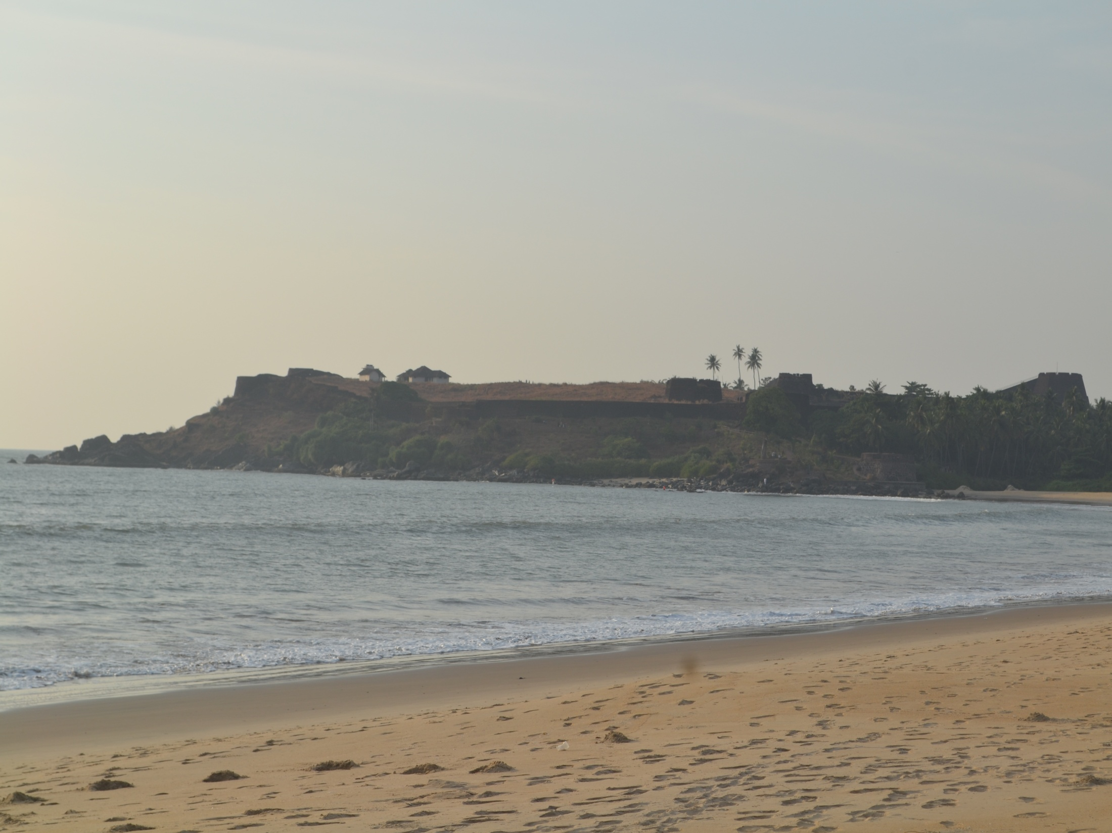


Situational Analysis of Beaches of Kerala
Experiences and Prospects
ESAF, INDIA
Arun AG

Slide 2
General Information
Beaches are the least used public spaces in Kerala
LSGs and Tourism Department are the responsible authorities for beach development

Slide 3
Study Results
None of the Kerala beaches are inclusive
Every beach lacks some kind of basic infrastructure

Slide 4
Study Results
Only 38% have proper safety measures
Waste management is a serious challenge
Only four beaches have children play area

Slide 5
ESAF Advantages
Conducted first ever Situational Analysis of the beaches
Vast experience and expertise in public space development

Slide 6
BEKAL -A MODEL BEACH
Situates near to Bekal Fort, one of the most exotic beaches of Kerala
Developed and maintained by BRDC

Slide 7
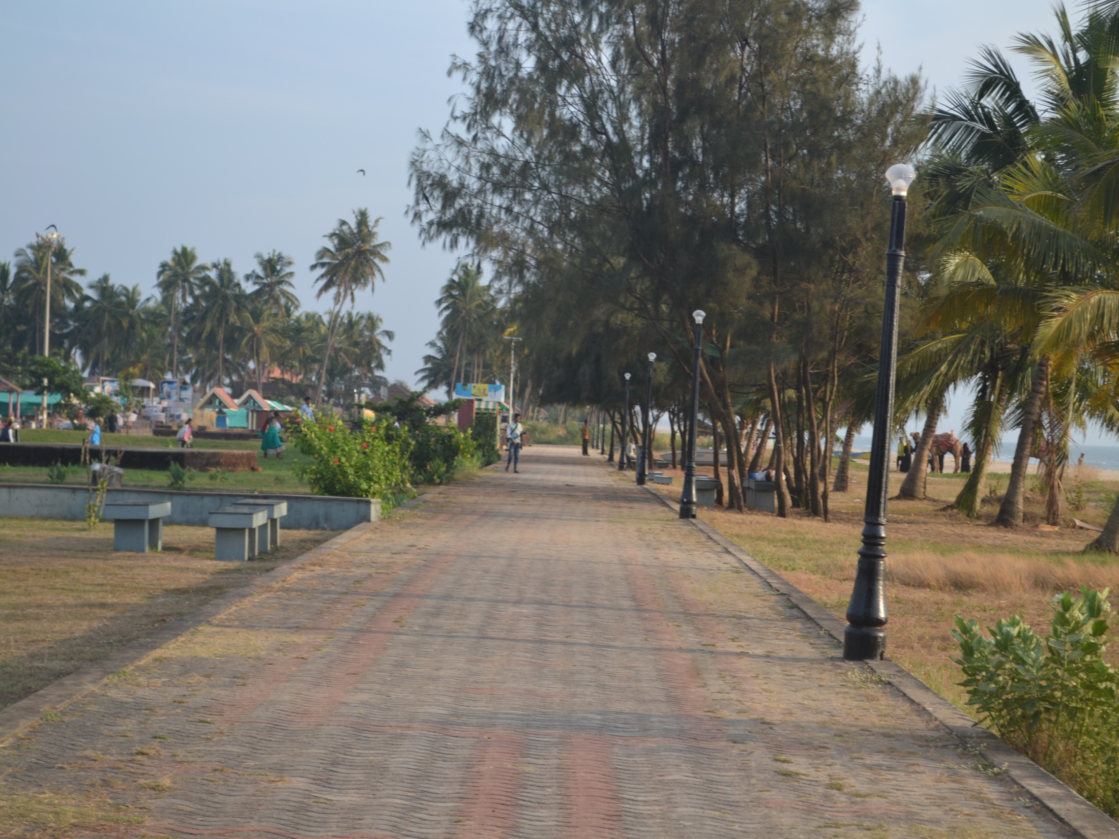
Walkway

Slide 8
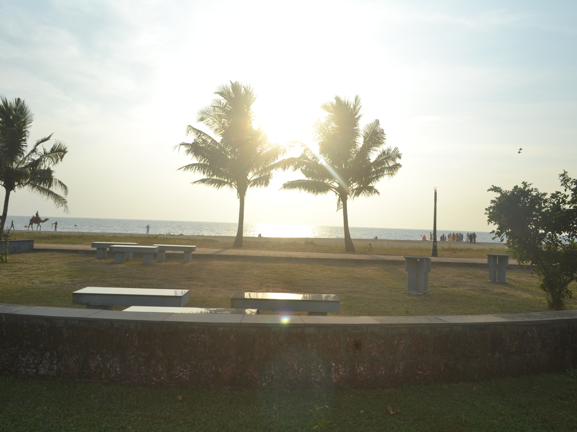
Beach Furniture

Slide 9
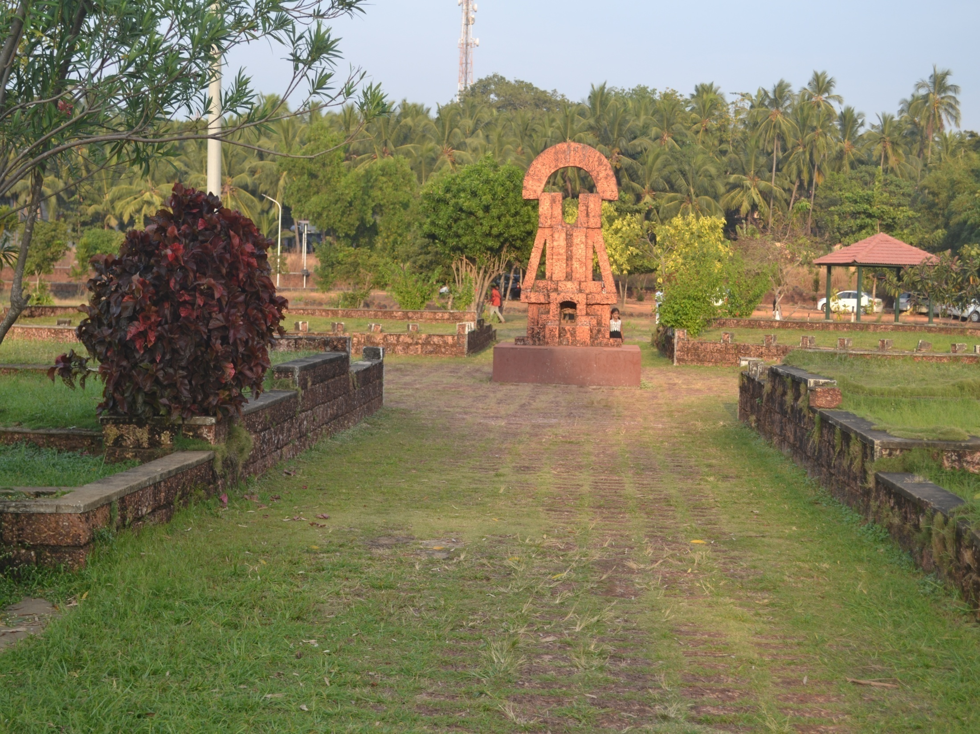
Attractive Monuments

Slide 10
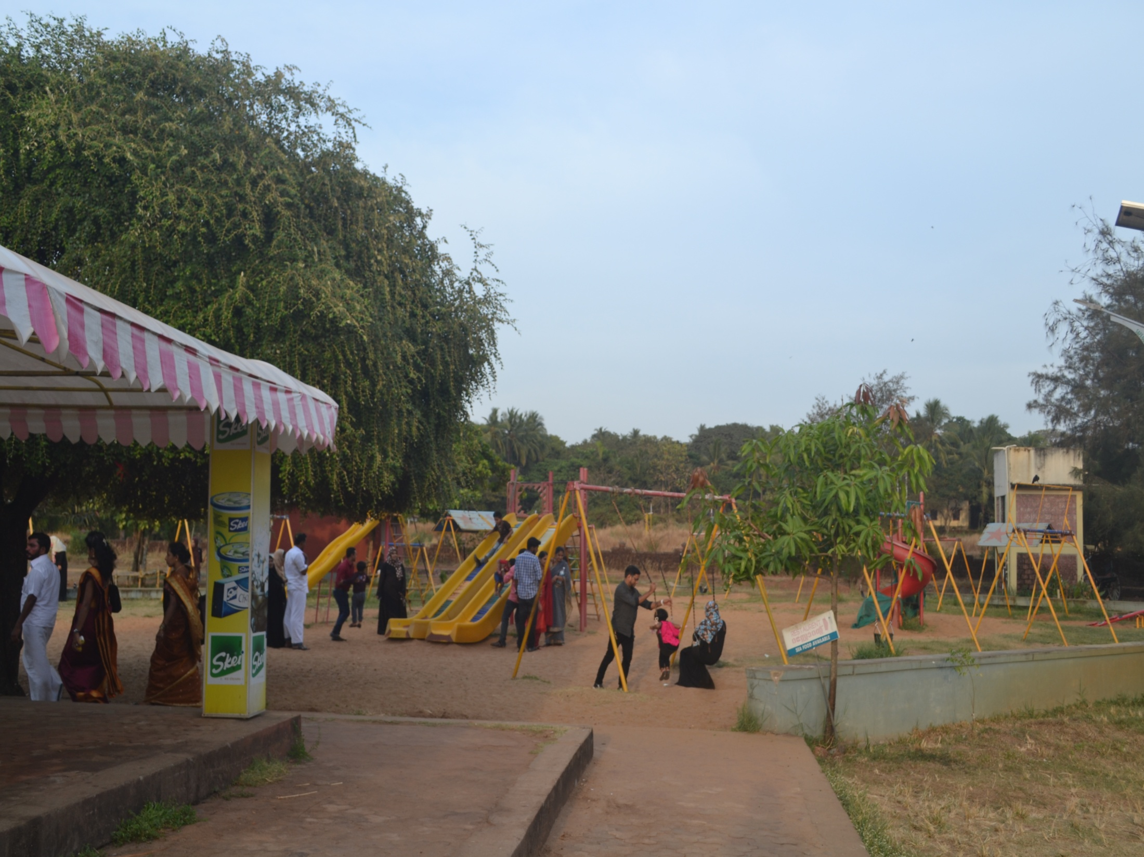
Children’s Park

Slide 11
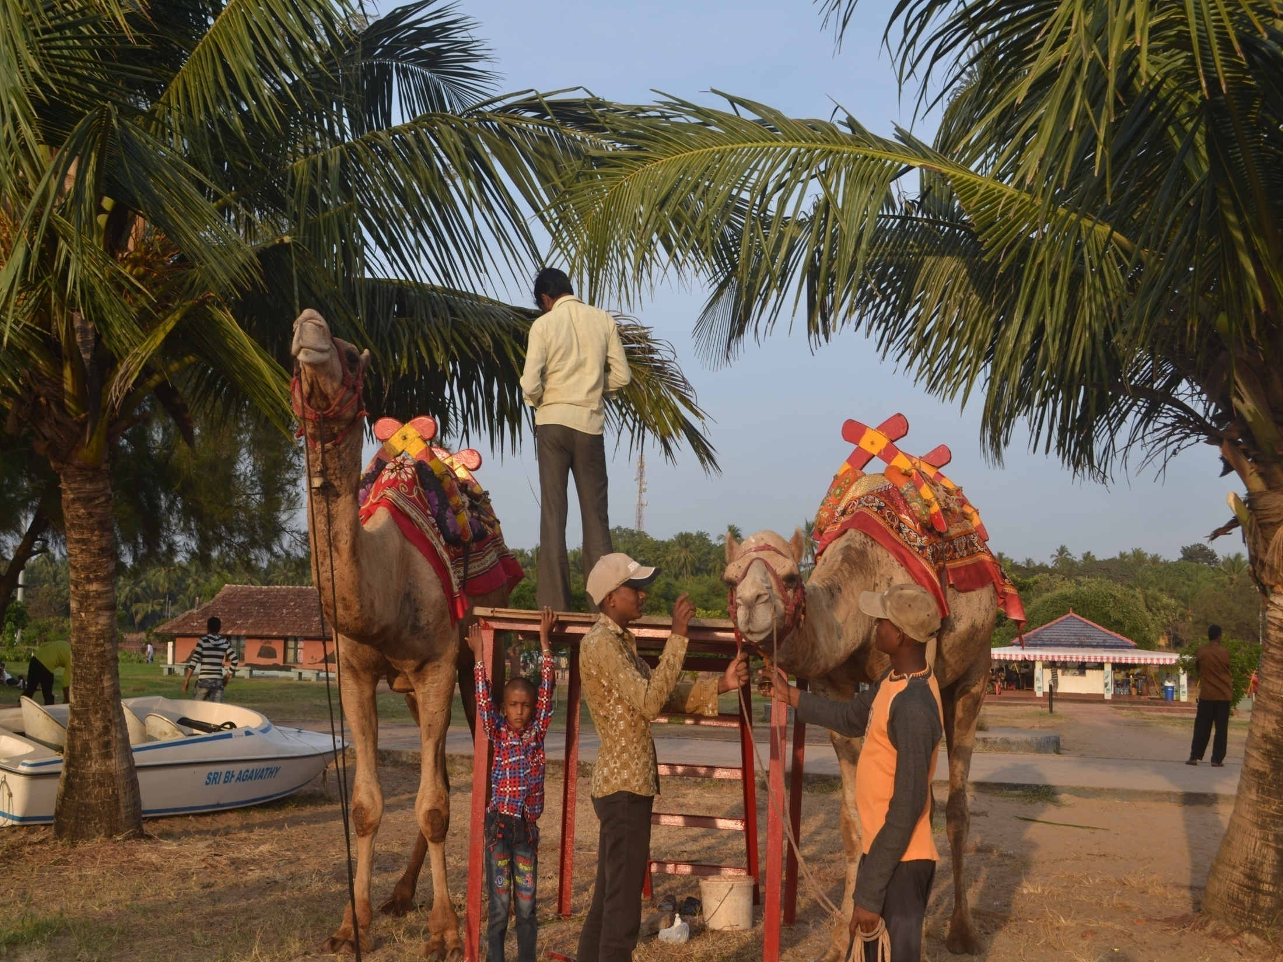
Camel Safari
Not inclusive and charge entry fees

Slide 12
Efforts Till Now
Submitted report to Five LSG authorities
Started process in two LSGs

Slide 13
Efforts Till Now
“Beach for All” campaign for Inclusive Public Spaces
The campaign received wide media coverage and publicity
ESAF Beach For All Campaign at Fort Kochi.mp4

Slide 14
Future Plan of Action
Work for developing sufficient infrastructure
Mobilize community and organize FGD and Design Charrette

Slide 15


